Slide 1
Trigger Tracker Application
Group 1: Tarsus Arciga
Long Dang
Ekrem Kalabak
Dalton Gilmore
Alexa Summers

Slide 2
Elements
Login Page
Add Triggers
Edit Triggers
View Transactions
View Notifications

Slide 3
Architecture
Reactive UI || Angular Application
Frontend Host & database connection || Spring Boot Application
Database || Maria DB Instance (using Azure)

Slide 4
Final Deliverables
Test Plan
Test Specifications
Test Reports
User Guide
System Guide

Slide 5
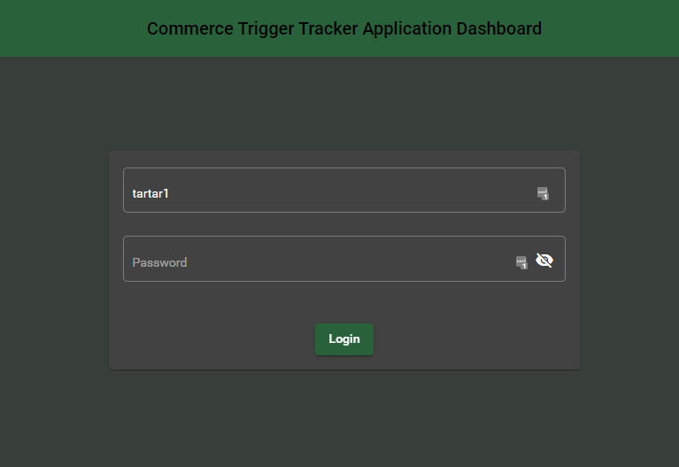
Login Page

Slide 6
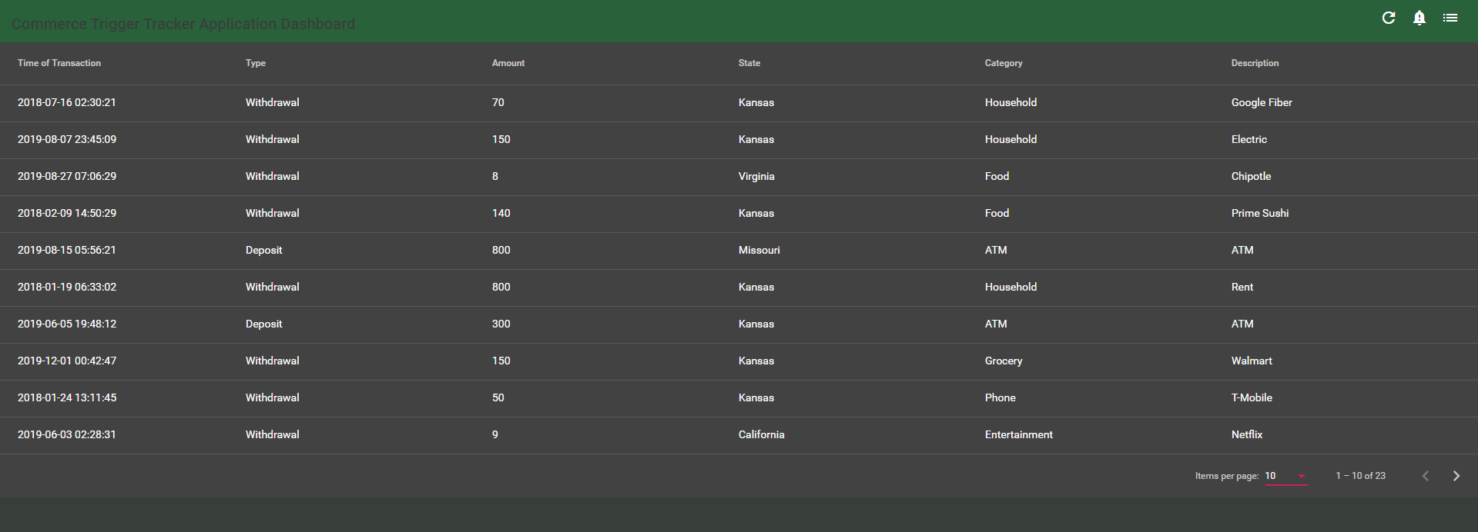
View Transactions

Slide 7
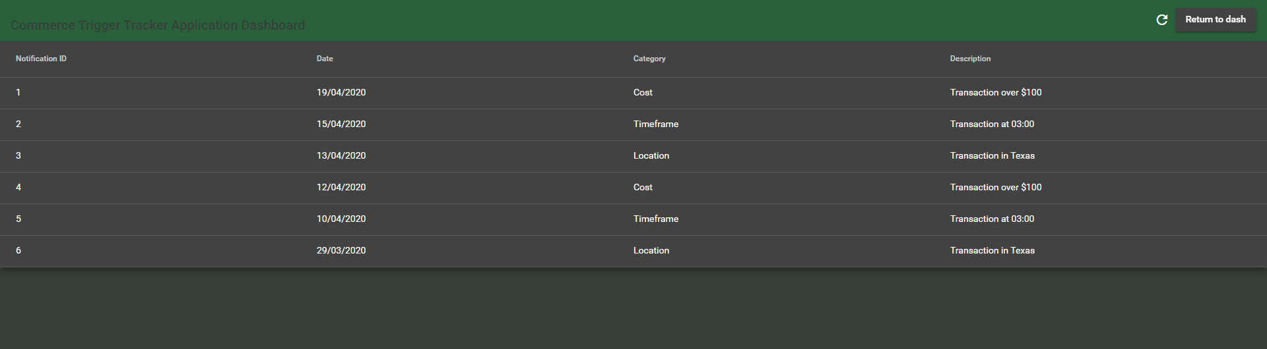
View Notifications

Slide 8
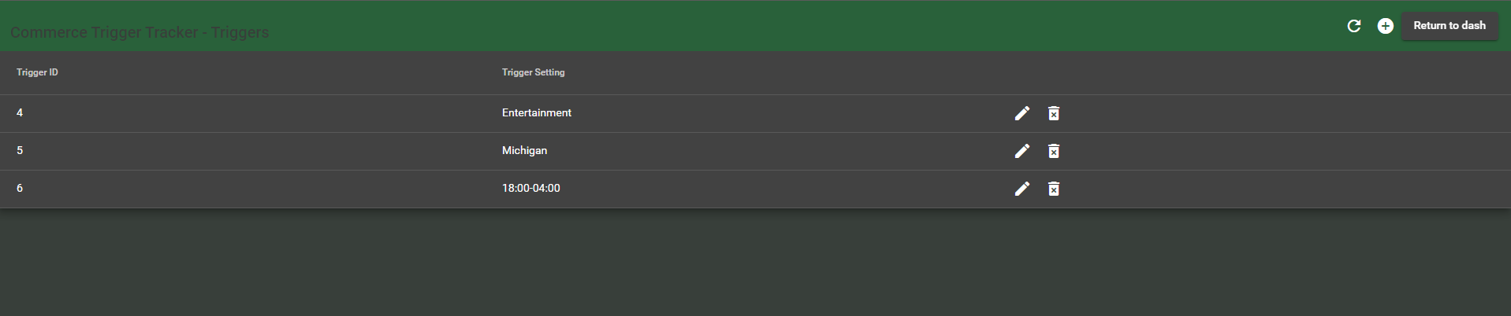
View Triggers

Slide 9
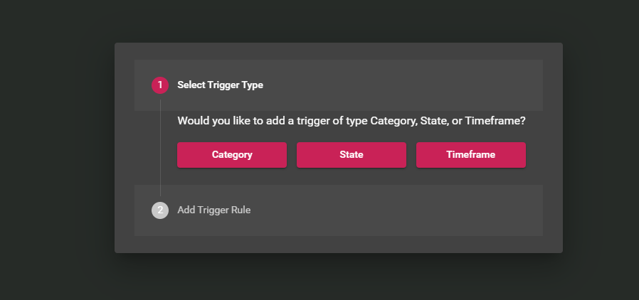
Create New Trigger

Slide 10
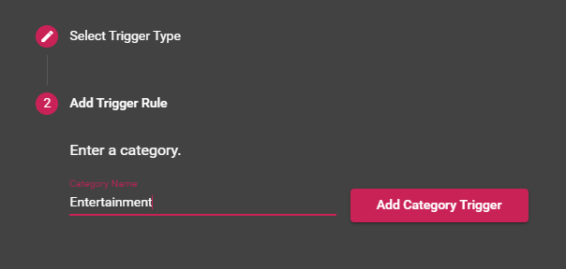
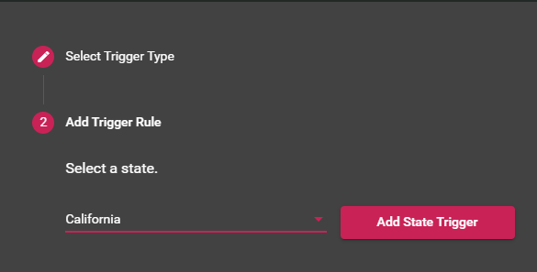
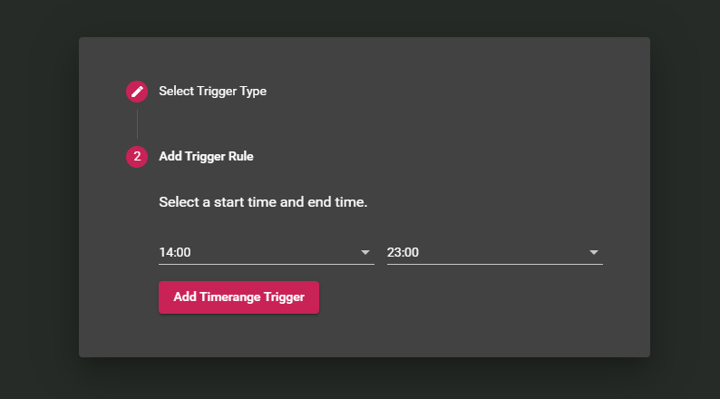
Create New Trigger
Category Trigger
State Trigger
Timeframe Trigger

Slide 11
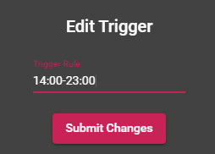
Edit Existing Trigger

